Slide 1
SAP BTP Extension Suite Training
Day 9
Anubhav Oberoy
www.AnubhavTrainings.com
Follow excellence with sheer passion

Slide 2


DISCLAIMER
The training content and delivery of this presentation is confidential, and cannot be recorded, or copied and distributed to any third party, without the written consent of Anubhav Trainings

Slide 3
Agenda – Day 9
01
Configuring xs-security.json
02
Deploying app with security
03
Understanding App Router

Slide 4




































Can we see the container
What happens when we deploy to hana behind the scene, explain again
How to test our app connected to HANA and if I want to run with sqlite
Can we run app with postgres not HANA to save cost
https://youtu.be/lnPhJRxZPwQ

Slide 5
Authentication v/s Authorization
Authentication – It ensures that is our user a valid user? Has he/she entered valid credentials to login to our app. It is enforced by a login screen. This login screen can also come from IDP like SSO, LDAP, Social integration.
Authorization – Once user is authentication, then the authorization comes into play. It ensures, is our user allowed to do certain activities inside app. What is the level of access. E.g. create, update, delete, approve, view.
SAP BTP cf environment has a special component called XSUAA –
XS – eXtended Services
UAA – User Account and Authorization
This is an in-built component inside of CF
It is responsible to control the user account and authorization
It manages our application security
In CF we use modular approach to address security
As a developer we need to decide what roles and level of security we need in our app. Example, we need to secure odata resource /Anubhav.svc
Usually we define Viewer, Editor
We need to define our scope and role templates inside a special file called xs-security.json file
XSUAA Communicates to the IDP – Identity Provider
Issues JWT (JSON web Token) to cloud foundry router which let user access the app based on permission.
Scope
(Role)
* *
Role Template
* *
Role Collection

Slide 6

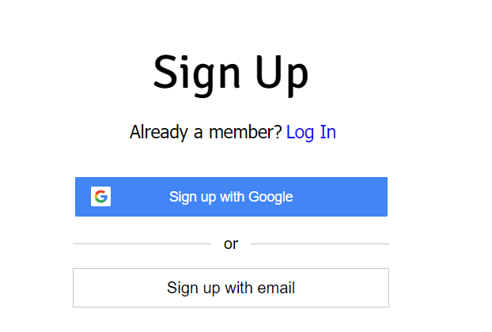









IDP – Identity Provider
An identity provider is a software or group of software which stores all the user credentials and their scopes (roles) in itself. This will centralize the user management in company and simplify the login process to different apps. This way user do not need to remember multiple passwords to multiple apps.
Portal
Launchpad
Dedicated SRM
SSO
SAP Server
GSuite
LDAP
User/email/password
Single source of truth
Trust relation
Scope- clerk, manager, ceo
Outlook
Our cloud app
xsuaa
XSUAA

Slide 7
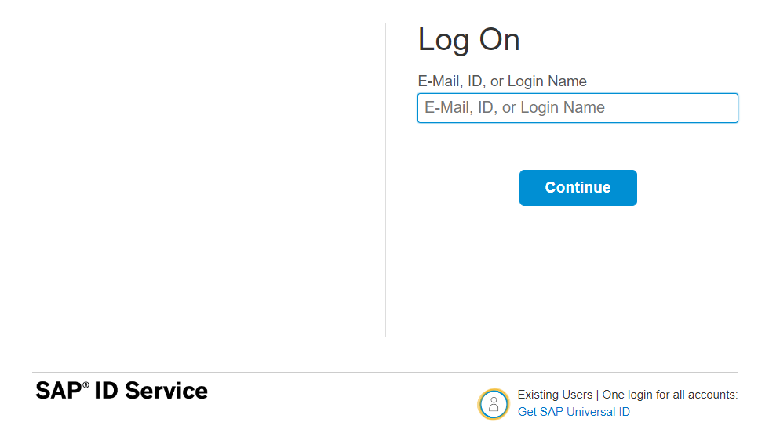
How it works behind scenes
xs-security.json contains information which we need to register to define what are all permissions required in our app
code
JWT
App
Browser
postman
ourxsuaa
trust
JWT
XSUAA
Scope
SAML
trust
IdP

Slide 8











































Slide 9

Hands-on Add Security and Test Microservice
cds add xsuaa

Slide 10
Xs-security.json
Xs-uaa backing service
BTP Account

Slide 11
Testing the Microservice from postman
After the deployment, we open the postman tool and try to access resource with URL /vendor url, it gives unauthenticated.
We need to obtain access token so we went to authorization table and added the OAuth2.0 option and provided
Properties | Value
Token Name | BTPJWTToken
Grant Type | Password credentials
Access Token URL | Service key of xsuaa – url, append /oauth/token
Client Id | Service key – client_id
Client Secret | Service key – client_secret
Username | Our BTP account user id
Password | Our BTP account password
3. Call get token and choose use token button once token was fetched.
4. Again make get request for /vendor, and we should get response.
5. If we try /vendor/, it will not work because, we are looking for Role.
6. Went to BTP subaccount and created a Role collection, added the role template and assign same to our user
7. Again get the token and try to access end point for OData, this time it works.

Slide 12
Challenges in Current Approach
Did you notice, that we need to first pass lots of technical details from service key
Pass all the info in correct manner to postman to obtain token
Once the token expired, we need to reobtain again and again
Our end user do not know all this. Automate the XSUAA JWT token processing.
In our app, we will have multiple microservices, like java, sap ui5, node app, xsuaa…
Each service produce one end point e.g. /vendors, /index.html, /customers, they all logically belongs to same app. Will you give 3 url to our user to access these apps?
These microservices also needs to communicate with each other. Provided we give a single end point to access our entire app to end user.
We want to complete redirect mechanism to let user go to login screen, authenticate on IDP and exchange of all the tokens should be seamless behind the scenes.
We need a single entry point for entire app, forwardAuth tokens should be done automatic.
url
Application router
(Provide single entry point, exchange auth token,
Communicate between microservices, like a facade)
xsuaa
Java
/Anubhav.svc
UI5 App
/index.html
Node
/customer

Slide 13
Introduction to App Router
It is a Node JS Application
It is used to automate the process of authentication, authorization with XSUAA to do token exchange
It sits in the middle of IDP and XSUAA, it will redirect the request to our microservice to xsuaa, and eventually to idp
IDP sends the login screen to the user, user authenticates, which is taken to XSUAA, XSUAA issues JWT Token, this JWT token is presented to api end points
App Router takes the JWT token from XSUAA and gives it to our microservices and even exchange this token to multiple microservices inside
It Serves as a single entry point for the entire app.
To tell app router about our multiple microservices so that it can re-direct, we need to create a configuration file named as xs-app.json which contains the details.

Slide 14



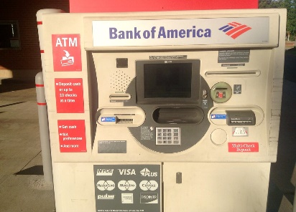
Real World Example
Customer
1
5
4
2
Loan
Credit Card
6
Validate, trust
Deposit
Draft/Cheque
3
FD
*******
7
Locker
This Photo by Unknown Author is licensed under CC BY

Slide 15
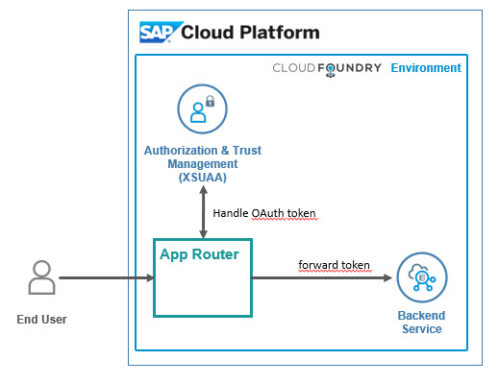
Hands on: App Router
Solution
https://github.com/soyuztechnologies/BTP_Architect_Training/blob/master/Day%203/04approuter.zip

Slide 16

What We Did
Let’s Summarize

Slide 17

www.anubhavtrainings.com
Thank You
End of Day 9

Slide 18


We’re committed to empower you to be
#FutureReady
through powerful training solutions.
We build the workforce of the future.
260+
Corporate Clients
60,000+
Learners Trained
26000+
Learners Placed
FREE WEBINARS
Sign up for free webinars with industry experts every fortnight!
Enroll Now!
Contact us today!
https://anubhavtrainings.com

